Slide 1
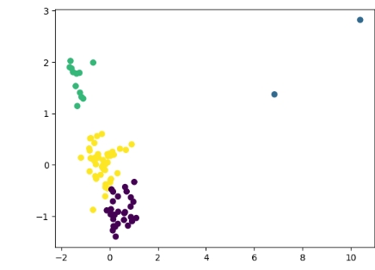
Customer Segmentation Strategy Using Machine Learning
Project Goal
Identify distinct customer groups based on purchasing behavior to support targeted marketing and business growth.
Key Result
Four customer segments were identified using machine learning clustering techniques.
Business Impact
Better customer targeting
Improved customer retention
More efficient marketing campaigns

Slide 2
Business Challenge
Current Business Challenge
Customers have different purchasing behaviors.
Why It Matters
Understanding customer differences is essential for maximizing revenue and customer loyalty.
👥 Customers 📈 Revenue 🎯 Marketing
Marketing campaigns are often applied uniformly.
High-value customers may not receive appropriate attention.
Inactive customers may be overlooked.

Slide 3
Project Objective
The project aimed to:
Segment customers based on purchasing behavior.
Identify high-value and low-engagement customers.
Support personalized marketing strategies.
Improve customer retention and profitability.
Customer Transactions
↓
RFM Analysis
↓
Customer Segments
↓
Business Actions

Slide 4
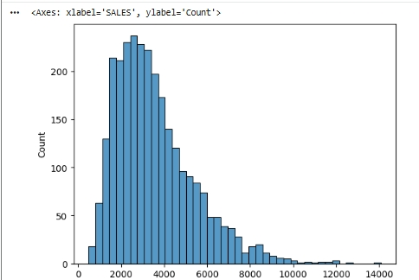
Key Customer Insights
What We Learned About Our Customers
Analysis revealed significant differences in customer behavior:
Sales Distribution
Some customers purchase frequently and spend heavily.
Some customers purchase occasionally
Some customers have not purchased recently.
Revenue is concentrated among a smaller group of customers.
.

Slide 5
Customer Segments Identified Customer Segments
Segment | Description
Cluster 0 | High-Value Customers
Cluster 1 | Loyal Customers
Cluster 2 | Occasional Buyers
Cluster 3 | At-Risk Customers
Business Meaning
Each segment requires a different engagement strategy.

Slide 6
Strategic Recommendations Recommended Actions
High-Value Customers
VIP programs
Exclusive offers
Loyal Customers
Loyalty rewards
Referral programs
Occasional Buyers
Promotional campaigns
Product recommendations
At-Risk Customers
Reactivation campaigns
Personalized discounts
Segment | Action
High Value | VIP Program
Loyal | Loyalty Rewards
Occasional | Promotions
At-Risk | Reactivation

Slide 7
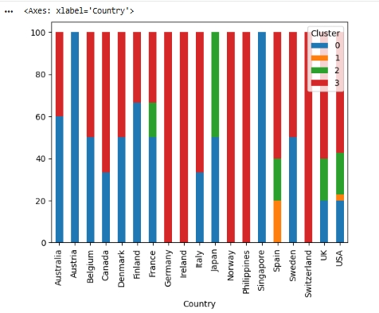
Risks and Ethical Considerations
Cluster Distribution Across Countries
Fairness Assessment
No demographic variables were available.
Geographic variables (Country and Territory) were analyzed.
No significant geographic bias was identified.
Risk Mitigation
Human oversight remains important.
Cluster assignments should support—not replace—business judgment.

Slide 8
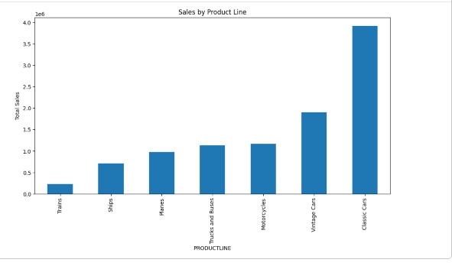
Business Value and Conclusion Expected Business Value
Sales by Product Line
Expected Benefits
Better customer targeting
Improved customer retention
Increased marketing efficiency
Stronger customer relationships
Revenue growth opportunities
Conclusion
Machine learning successfully identified meaningful customer segments that can support more effective marketing and business strategies.

